Slide 1
Building A New Restaurant in Gurgaon neighbourhood
Introduction
Gurgaon, officially Gurugram, is a city located in the northern Indian state of Haryana. It is situated near the Delhi-Haryana border, about 30 kilometres (19 mi) southwest of the national capital New Delhi and 268 km (167 mi) south of Chandigarh, the state capital. It is one of the major satellite cities of Delhi and is part of the National Capital Region of India. As of 2011, Gurgaon had a population of 876,900
Business Problem
There are many malls, offices and restaurants located in Gurgaon. But the range of the restaurants in terms of finance is either too high or too low. Most of the restaurants are located around areas for shopping and partying. The areas around the offices mostly lack in good restaurant service. So, through this project I will find a suitable place which requires a good, formal restaurant in the mid-range.

Slide 2
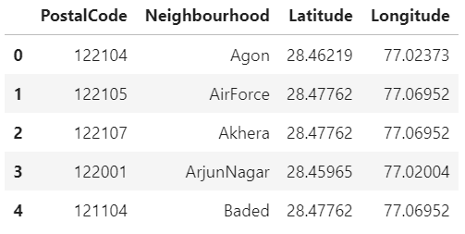
Neighbourhoods Data
The data with the neighbourhood, latitude and longitude information was loaded into a dataframe from the csv file.

Slide 3
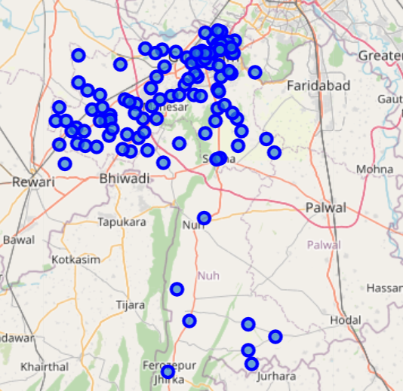
Gurgaon Map with Neighbourhood

Slide 4
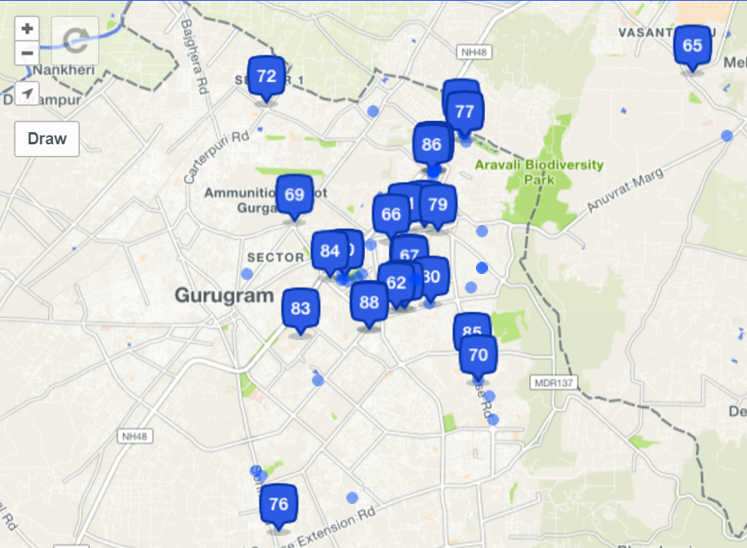
Foursquare API Restaurant Data
The Foursquare location data will provide the nearby restaurant information.

Slide 5
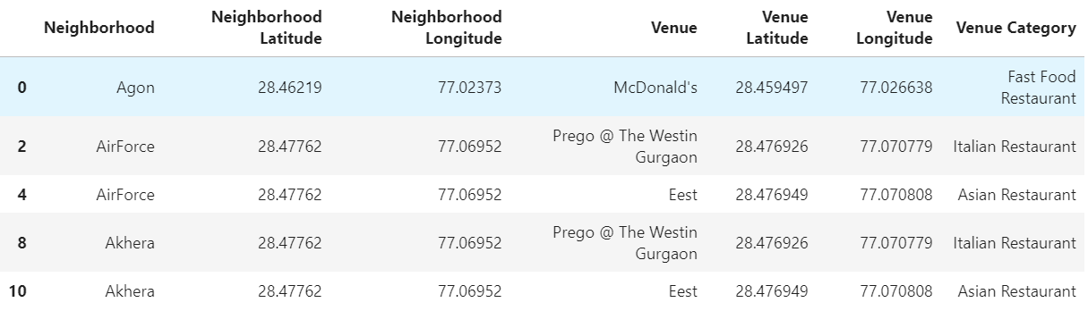
Dataframe with Venue Data
From Foursquare, the venues in each neighbourhood and their respective latitude and longitude was obtained.

Slide 6
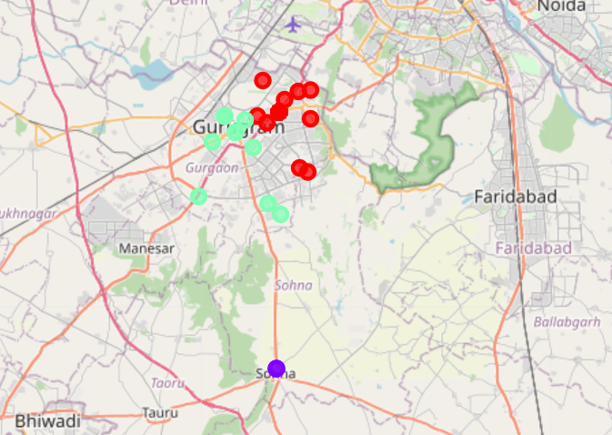
K Means Clustering
k-means clustering is performed. K-means clustering algorithm identifies k number of centroids, and then allocates every data point to the nearest cluster, while keeping the centroids as small as possible.

Slide 7
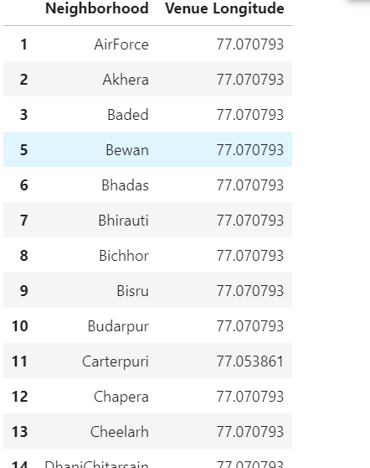
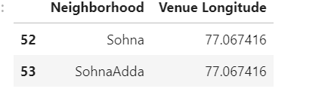
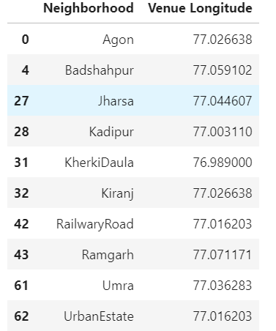
Results
The three clusters formed are as follows:
Cluster 0: It has 54 neighbourhoods having restaurants
Cluster1: It has 2 neighbourhoods having restaurants
Cluster 2: It has 10 neighbourhoods having restaurants

Slide 8
Conclusion
From this model the conclusion can be derived that setting up a new restaurant in the neighbourhoods around cluster 1 would be recommended. There are many others factors which should be taken into account for the best place to set it up.
References
Neighbourhood data from https://www.kaggle.com/karansud/neighborhoods-of-gurgaon-with-latlong.
Foursquare Api
http://www.zinkohlaing.com/data-science/using-machine-learning-to-find-locations-to-open-a-burmese-restaurant-in-toronto-ibm-capstone-project/

